Slide 1

Team 11: Mobile Price Classification
Data Science, Columbian College of Arts & Sciences
DATS 6202
Machine Learning I

Slide 2
Problem Statement
Bob has started his own mobile company and wants to compete with big players like Apple and Samsung. However, he's unsure how to price his mobile phones competitively. To tackle this, he gathers sales data from various companies to understand the relationship between different features (e.g., RAM, internal memory) and selling prices. Bob needs assistance in analyzing this data and building a model to predict price ranges for his mobile phones based on their specifications. By doing so, Bob aims to make informed pricing decisions and establish his company in the competitive mobile phone market.

Slide 3
Solution
Our aim is to predict the price range of mobile phones based on their specifications. We'll explore different classification models to find the one that best predicts phone prices accurately. By comparing models using metrics like accuracy, we'll identify the most effective one for this task.

Slide 4
Implementation
The Pipeline for Regression and Classification:
Loading the data Splitting the data Handling uncommon features Handling identifiers Handling date time variables | Handling missing data Encoding the data Splitting the feature and target Scaling the data Feature selection & feature engineering

Slide 5
Data Description
21 columns
battery_power: The total energy a battery can store in milliampere-hours (mAh).
blue: Indicates the presence of Bluetooth (1 if present, 0 if absent).
clock_speed: The speed at which the microprocessor executes instructions, measured in gigahertz (GHz).
dual_sim: Indicates whether the device supports dual SIM cards (1 if supported, 0 if not supported).
fc: Front Camera megapixels.
four_g: Indicates the presence of 4G connectivity (1 if present, 0 if absent).
int_memory: Internal Memory capacity in gigabytes (GB).
m_dep: Mobile Depth in cm.
mobile_wt: Weight of mobile phone in grams.
n_cores: Number of cores of the processor.

Slide 6
Data Description
21 columns
pc: Primary Camera megapixels.
px_height: Pixel Resolution Height.
px_width: Pixel Resolution Width.
ram: Random Access Memory capacity in megabytes (MB).
sc_h: Screen Height of mobile in cm.
sc_w: Screen Width of mobile in cm.
talk_time: The longest time that a single battery charge will last when you are on a call.
three_g: Indicates the presence of 3G connectivity (1 if present, 0 if absent).
touch_screen: Indicates whether the device has a touch screen (1 if present, 0 if absent).
wifi: Indicates whether the device supports Wi-Fi (1 if supported, 0 if not supported).
price_range: This is the target variable with values indicating the price range of the mobile phone.

Slide 7
Data Description
21 columns
pc: Primary Camera megapixels.
px_height: Pixel Resolution Height.
px_width: Pixel Resolution Width.
ram: Random Access Memory capacity in megabytes (MB).
sc_h: Screen Height of mobile in cm.
sc_w: Screen Width of mobile in cm.
talk_time: The longest time that a single battery charge will last when you are on a call.
three_g: Indicates the presence of 3G connectivity (1 if present, 0 if absent).
touch_screen: Indicates whether the device has a touch screen (1 if present, 0 if absent).
wifi: Indicates whether the device supports Wi-Fi (1 if supported, 0 if not supported).
price_range: This is the target variable with values indicating the price range of the mobile phone.

Slide 8
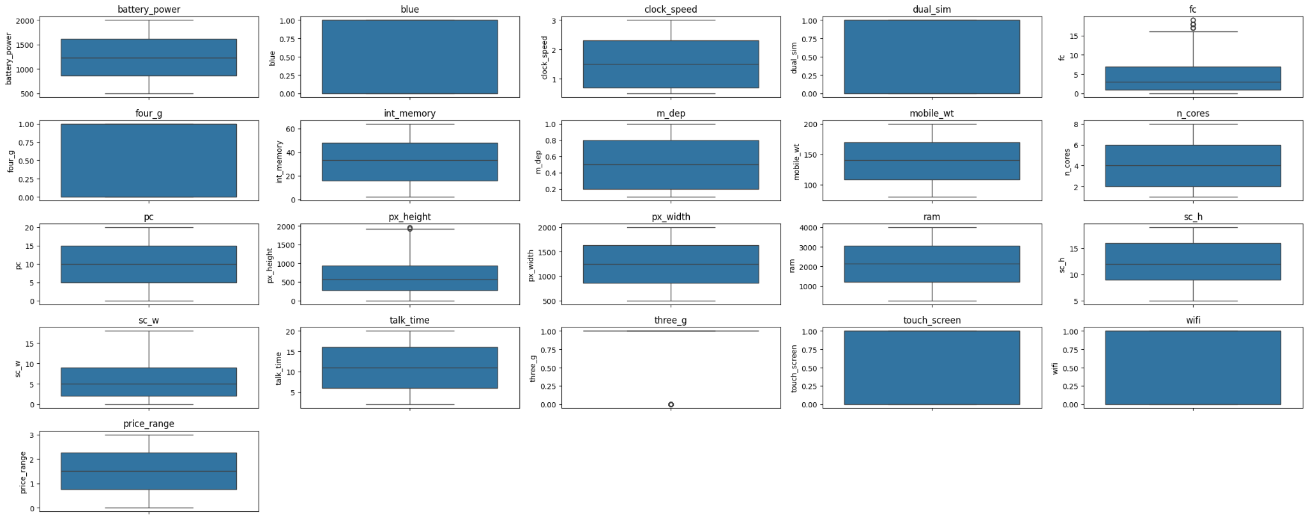
EDA

Slide 9
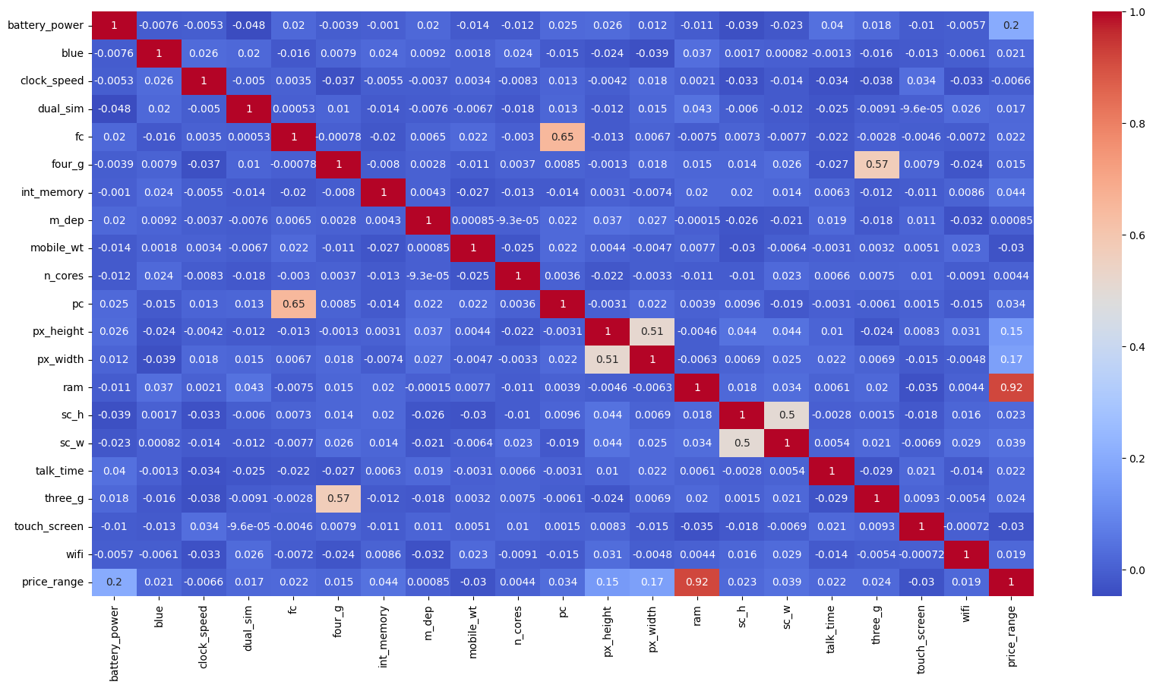
Heat Map

Slide 10
ML Algorithms
Logistic Regression
MLPClassifier
RandomForestClassifier
Hist GradientBoostingClassifier

Slide 11
ML Algorithms - Best Score
Logistic Regression - 0.979462
MLPClassifier - 0.901794
RandomForestClassifier - 0.886373
Hist GradientBoostingClassifier - 0.915545

Slide 12
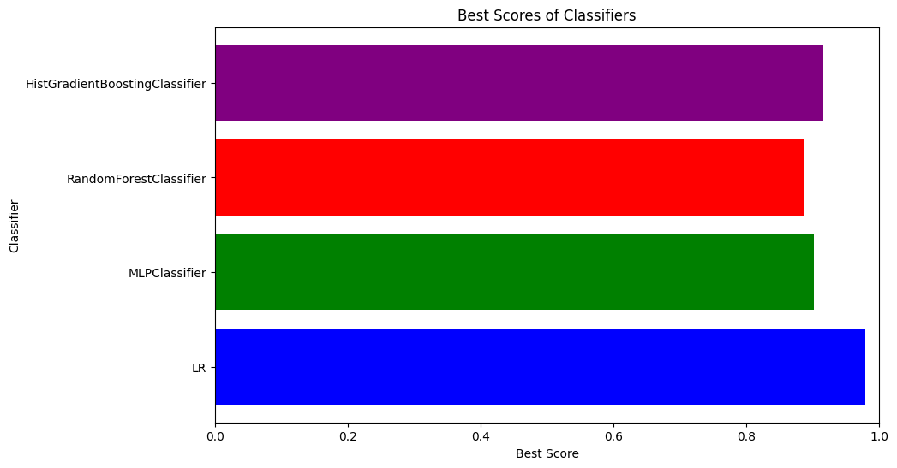
ML Algorithms - Best Score

Slide 13
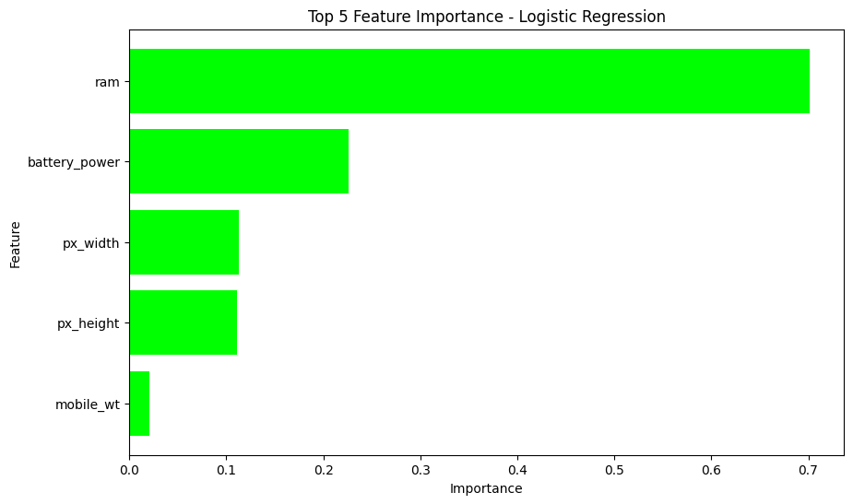
Feature Importance

Slide 14
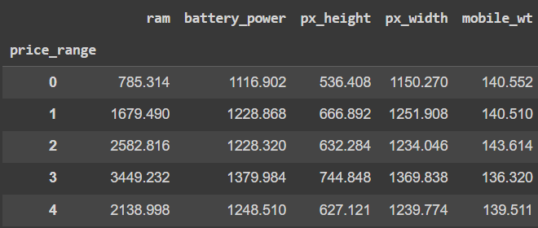
Multivariate Visualization

Slide 15
Conclusion
After evaluating various machine learning classification models for predicting phone price ranges based on specifications, we found that logistic regression emerged as the best fit for this task. With an accuracy of 0.979462, logistic regression outperformed other models in accurately classifying phone prices. Therefore, we recommend utilizing logistic regression for predicting phone price ranges in future applications.

Slide 16
References
yuxiaohuang/teaching/p2 c2 s5 tree_based_models/case_study
Kaggle-Mobile Price Classification
Project layout - Referred to table 3 on page 20 of the lecture slides.

Slide 17
Thank You
-

